Slide 1


Multi-Scale Supervised Learning-Based Channel Estimation for RIS-Aided Communication Systems
Jian Xiao∗, Ji Wang∗, Wenwu Xie†, et.al.
∗Department of Electronics and Information Engineering,
Central China Normal University,
†School of Information Science and Engineering,
Hunan Institute of Science and Technology.
May, 2023
Notes:
Hello everyone, in this talk, we will present a multi-scale supervised learning-based channel estimation framework for RIS-aided communication systems.

Slide 2
Background
Proposed solution
Simulation results
Future Directions
Notes:
This presentation will be divided into four parts.

Slide 3
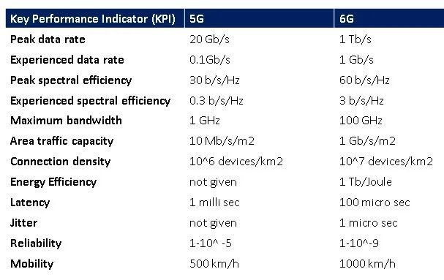
Background
KPIs in 6G communications [1]
  Green Communication (Energy consumption, Carbon emission)
  Intelligent Communication (AI 4 Net, Net 4 AI)
[1] Samsung, “6G The next hyper——Connected experience for all,” 2020.
Notes:
Firstly, we compare the KPI of 6G communications with 5G communications. As summarized in this table, we found various KPIs is significantly increasing in the 6G era. Moreover, we also concern new communication metrics for future communication, such as green communication and AI-driven intelligent communication.

Slide 4
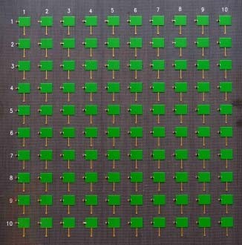
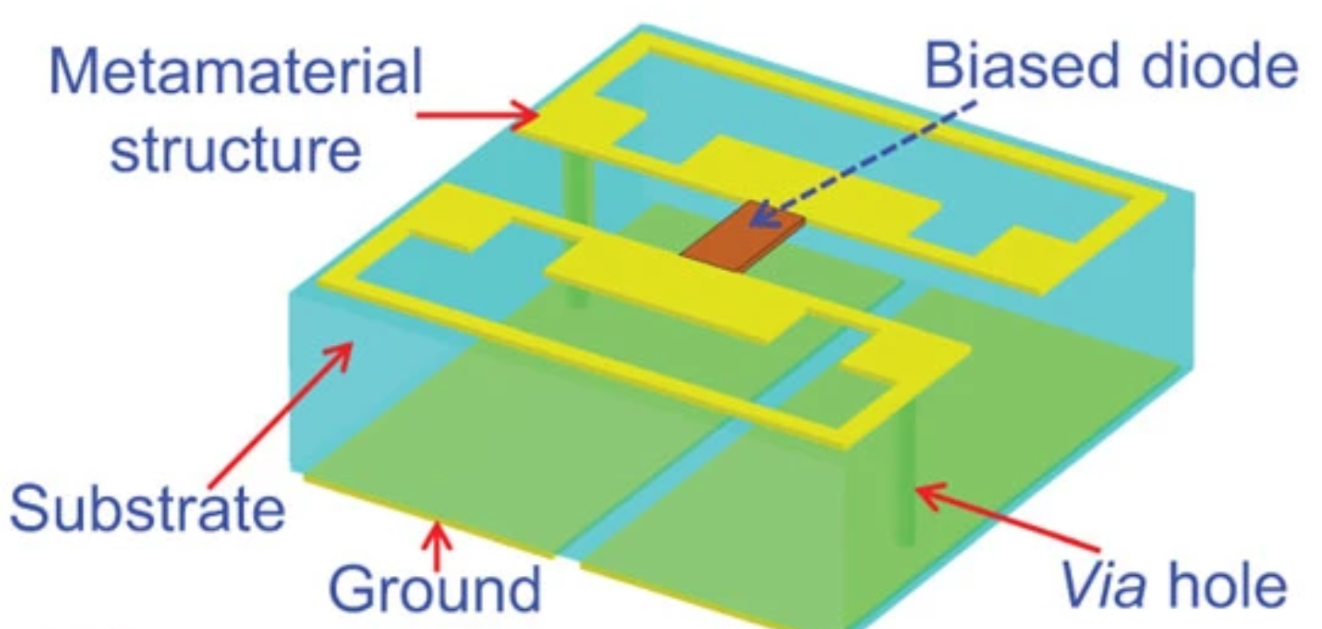
Background
Reconfigurable Intelligent Surface, RIS
  A meta-surface controlling the propagation of electromagnetic wave [2]
  Dominated Advantages
    Passive signal focusing
    Boosting the rank of MIMO communications
  Key Challenges
    Joint active and passive beamforming
    High dimensional cascaded channel acquisition
[2] C. Liaskos,et al. “A new wireless communication paradigm through software controlled metasurfaces,” IEEE Commun. Mag., Sept. 2018.
Notes:
In order to cope with the new challenges, a new wireless communication paradigm through software controlled metasurfaces has provoked increasing attention in the evolution towards 6G communication. Compared with existing massive MIMO technology, RIS can realize the signal enhancement with low energy consumption. The most promising applications of RIS depend on the accurate channel state information to design the passive beamforming
of RIS. However, the channel estimation is the key challenge for RIS-aided massive MIMO communication system.

Slide 5
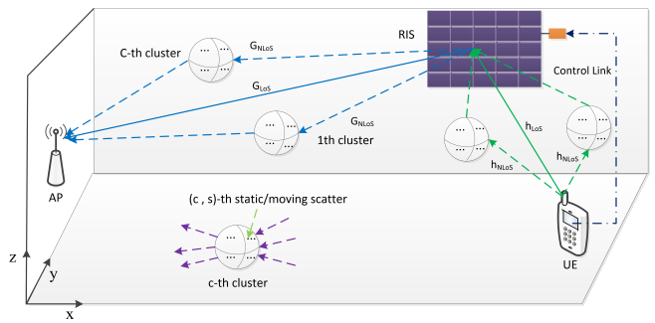
System Model
RIS-aided indoor mmWave communications
  Signal model (focusing cascaded link)
  Channel model (mmWave cluster MIMO channel [4])
AP : yz plane
RIS: xz plane
[4] E. Basar, I. Yildirim and F. Kilinc, “Indoor and outdoor physical channel modeling and efficient positioning for reconfigurable intelligent surfaces in mmWave bands,” IEEE Trans. Commun., 2021.
Notes:
In this work, we study a RIS-aided indoor mmWave communication system, in which we adopt the cluster MIMO channel model to capture the dynamic variations of the environmental objects, e.g., a large number of randomly distributed scattering elements between the terminals and the RIS.

Slide 6
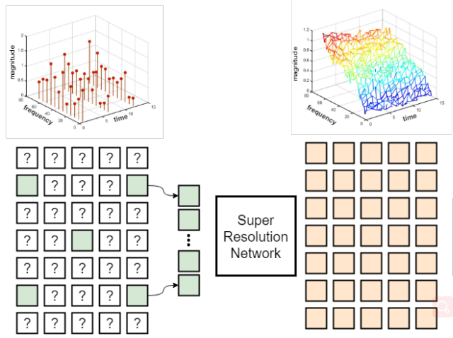
Prior Channel Estimation Schemes
Linear Estimator
  Expensive pilot overhead
Compressed Sensing Estimator
  Sparsity uncertainty and NP hard problem
Channel Extrapolation (SR-based)
  Single-step upsamping
  Pre-upsampling in SRCNN [3]
  Post-upsampling in EDSR [4]
[3] Y. Wang, et al. IEEE Commun. Lett. 2021
[4] Y. Jin, et al. IEEE Trans. Veh. Technol. 2020
Notes:
Firstly, we review existing channel estimation schemes in RIS systems. A classic linear estimator is least square estimator. Due to the constraint of full-rank condition, the required minimum pilot overhead is the number of reflection elements N, which causes intractable training overhead. Another alternative is to take advantage of the sparsity of channel in a specific transform domain by utilizing the compressed sensing methods. However, the correlation of the actual channel may not be confined to a single exact domain that fully represent the internal sparse structure of cascaded channel. Channel extrapolation strategy is also a popular pilot reduced methods, in which deep learning-based super-resolution networks are widely used to achieve the mapping from low-dimensional partial channel matrix to complete channel matrix. In the SR-based channel estimation model, the channel extrapolation was realized with single-step upsamping operations, such as the pre-upsampling in the input layer of SRCNN or the post-upsampling in the output layer of EDSR, which restricts the reconstruction precision of channel estimation with limited pilot length due to the larger upscale factor.

Slide 7
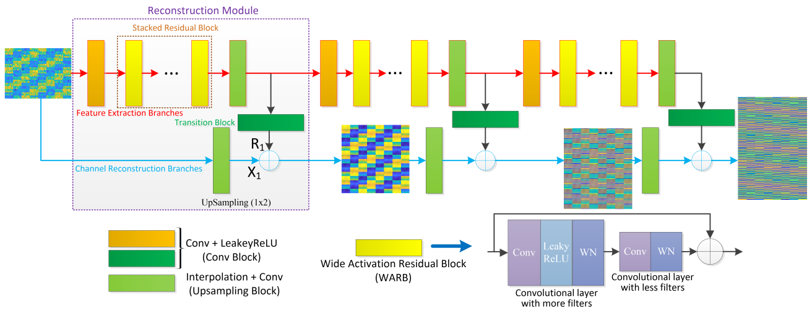
Proposed Solution
Laplacian Pyramid Networks
  Multi-scale: progressive reconstruction in different spatial scales
  Dual-branch: Information fusion between high- and low-frequency feature
Notes:
In this work, we propose a multi-scale supervised learning-based cascaded channel estimation scheme, where we design the Laplacian pyramid network to progressively reconstruct the cascaded channel in a coarse-to-fine fashion, instead of one step reconstruction. Specifically, the proposed network is divided multiple reconstruction modules in different spatial scales, and the multi-scale loss function is constructed to realize the progressive reconstruction. Besides, we introduce residual learning to fuse the high-frequency and low-frequency features of cascaded channel by design dual-branch architecture, i.e., feature extraction branch and channel reconstruction branch. In fact, with the increase of network layers, the representation of
network will contain more high-frequency information, while the low-frequency information is also important for the super-resolution channel estimation. Moreover, wide activation residual blocks are used in the interior structure of feature extraction branch to improve the feature extraction ability of network.

Slide 8
Simulation Setup
Simulation scenario
Parameter | Value
The number of RIS elements N | N =16 × 16
The number of RIS elements M | M = 8 × 8
The carrier frequency f | f = 28 GHz
The scatters distribution
The clusters distribution
Path loss model | 3GPP TR 38.901 V16.1.0
Network Hyper-parameters
Hyper-Parameter | Value
Level of Pyramid S | S = 3
The size of convolutional filters | M = 3 × 3 × 96
The number of WARBs W | W = 4 × S
The initial learning rate η0 | η0 = 5 ×10 ⁻³
The regularization parameter ε | ε = 10⁻⁶
Training epochs E | E = 100
Notes:
Next, we will present the simulation results of this work. The main simulation parameters and network hyper-parameters are summarized in this two tables.

Slide 9
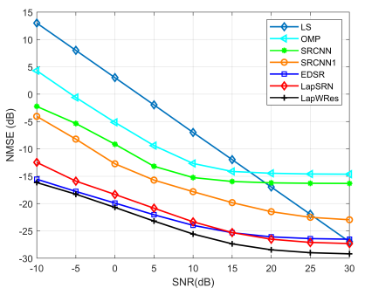
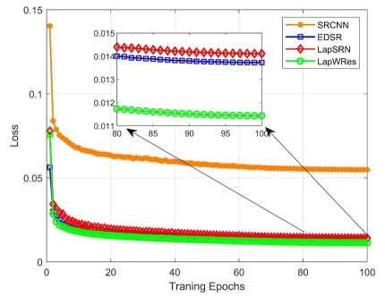
Simulation Results
Benchmarks
  Model-based schemes : LS estimator, OMP estimator
  Data-driven schemes: SRCNN, EDSR, LapSRN
  Lower channel estimation error
  Faster convergence speed
Notes:
In this simulation, we compared with existing model-based and data-driven channel estimation benchmarks. As shown in figures, the proposed channel estimation model with limited pilot overhead outperforms other estimation schemes, in terms of channel estimation accuracy and network convergence speed.

Slide 10
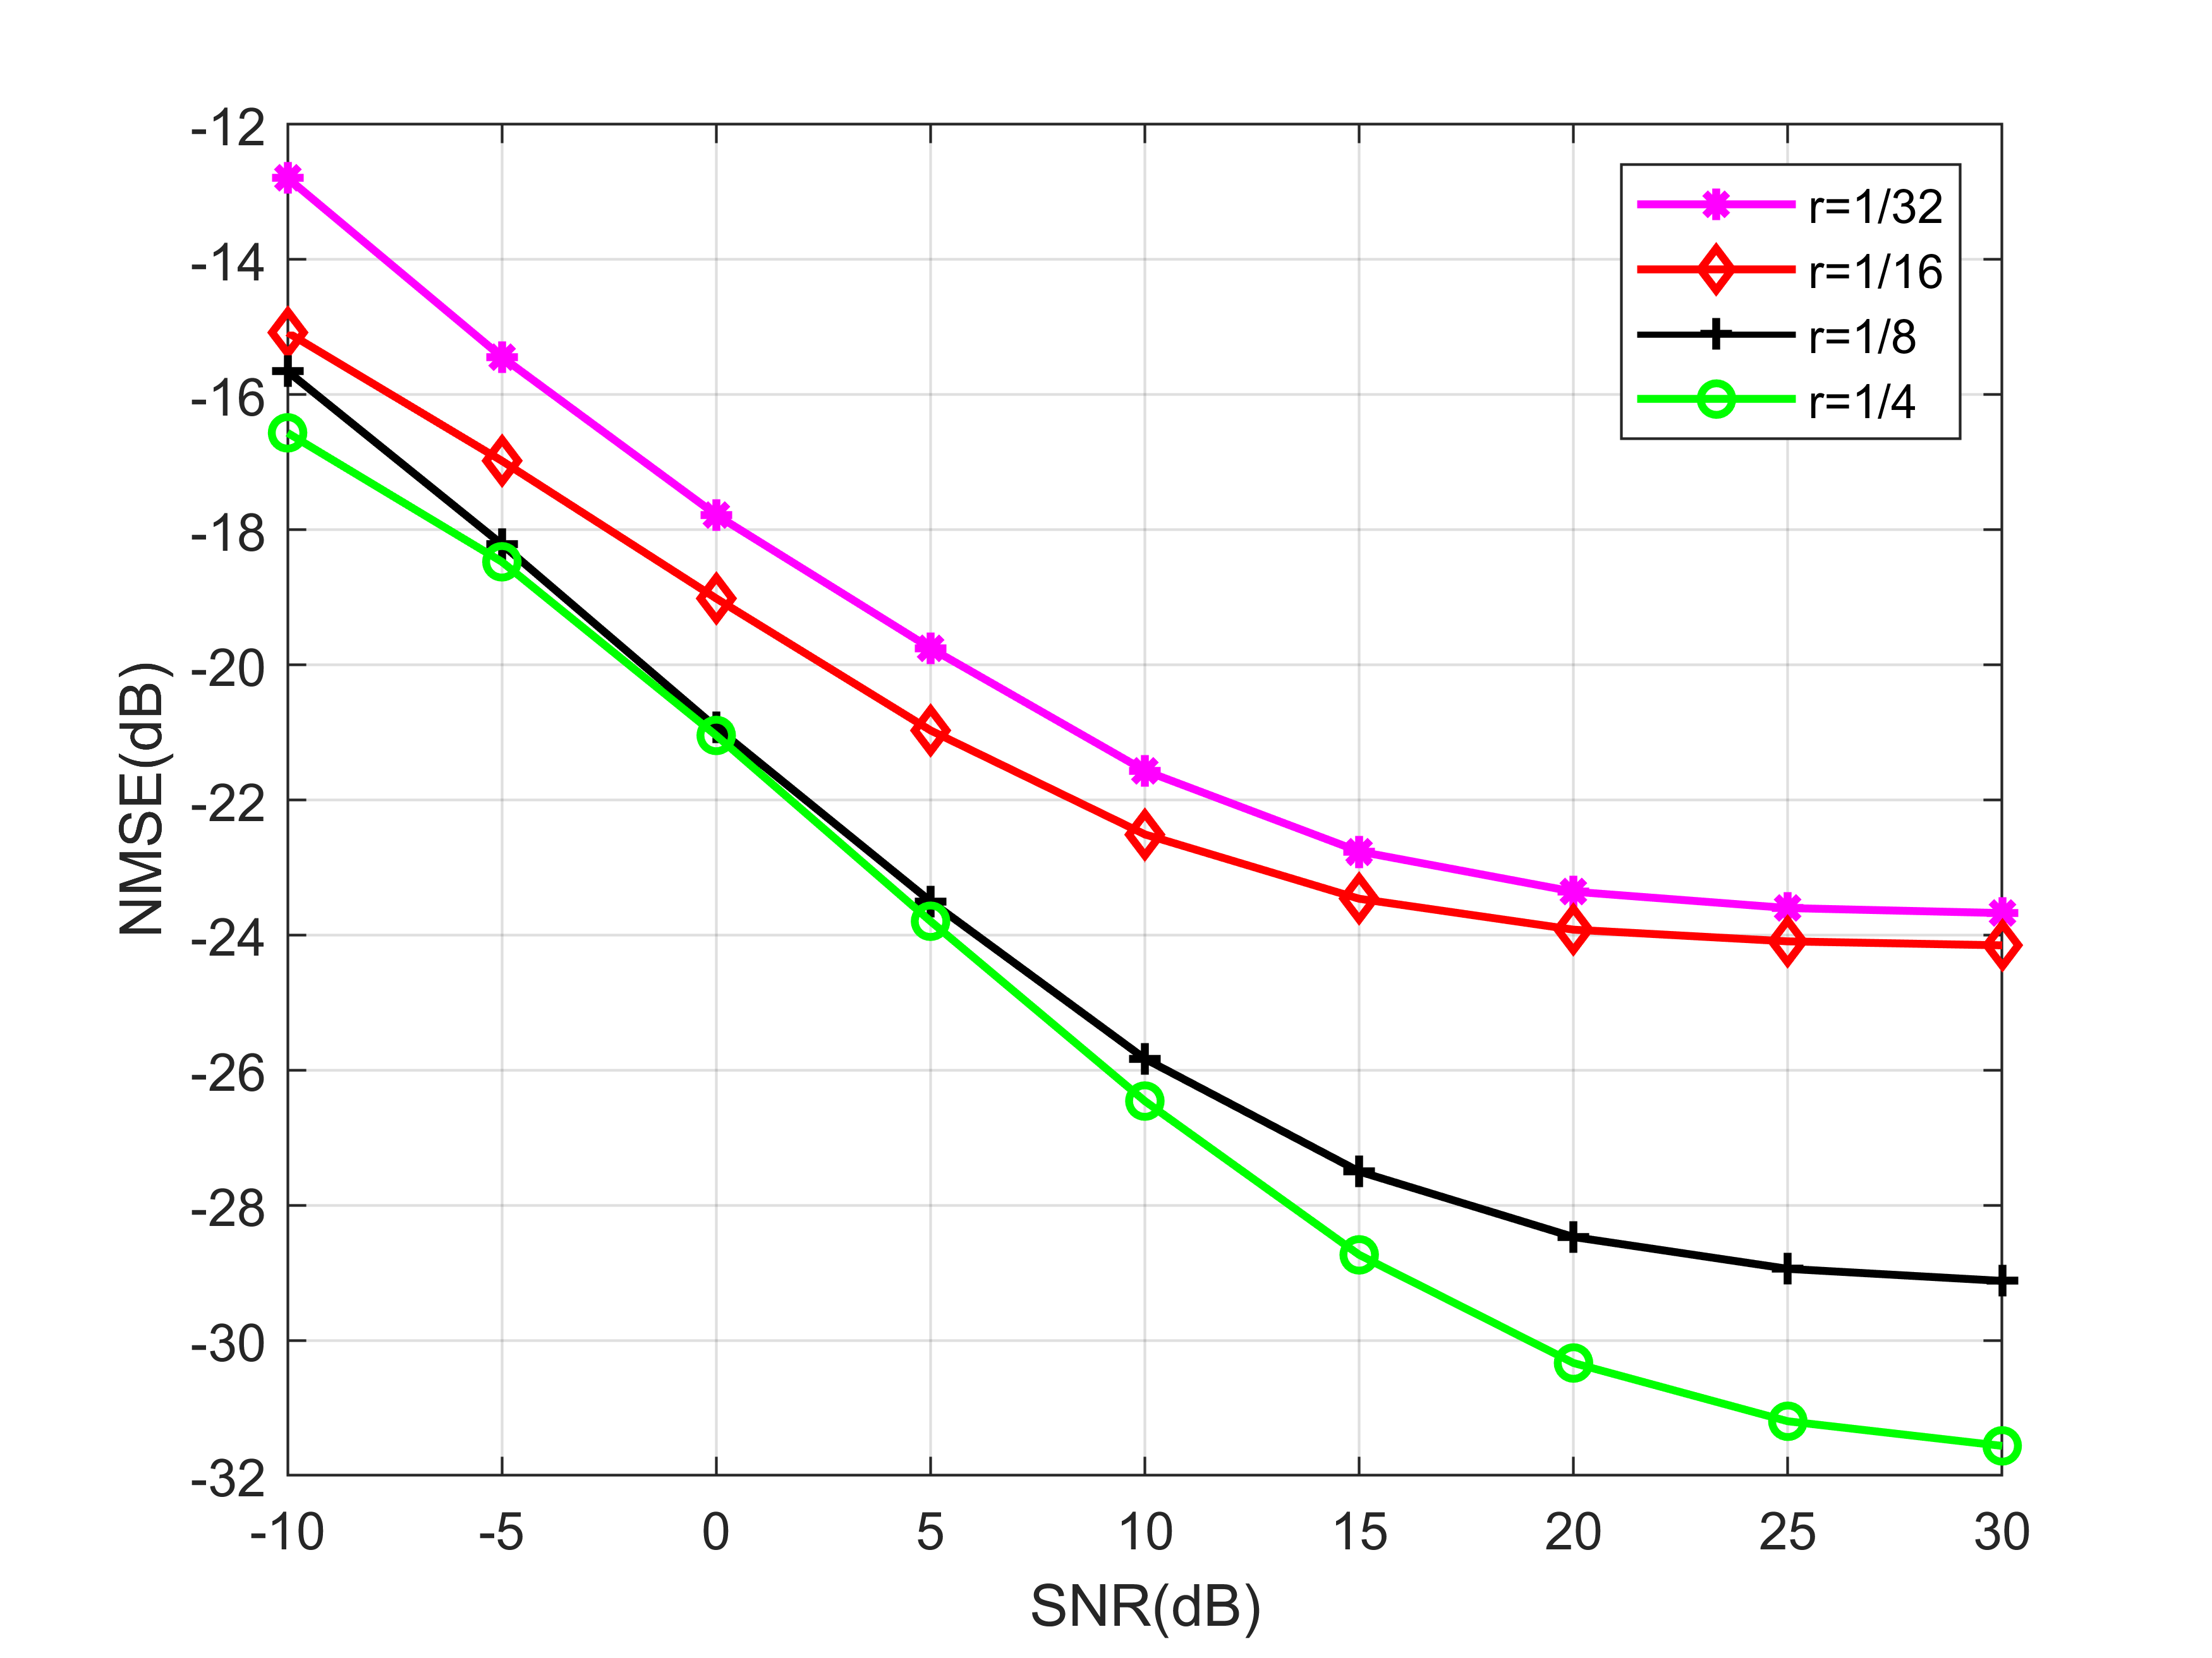
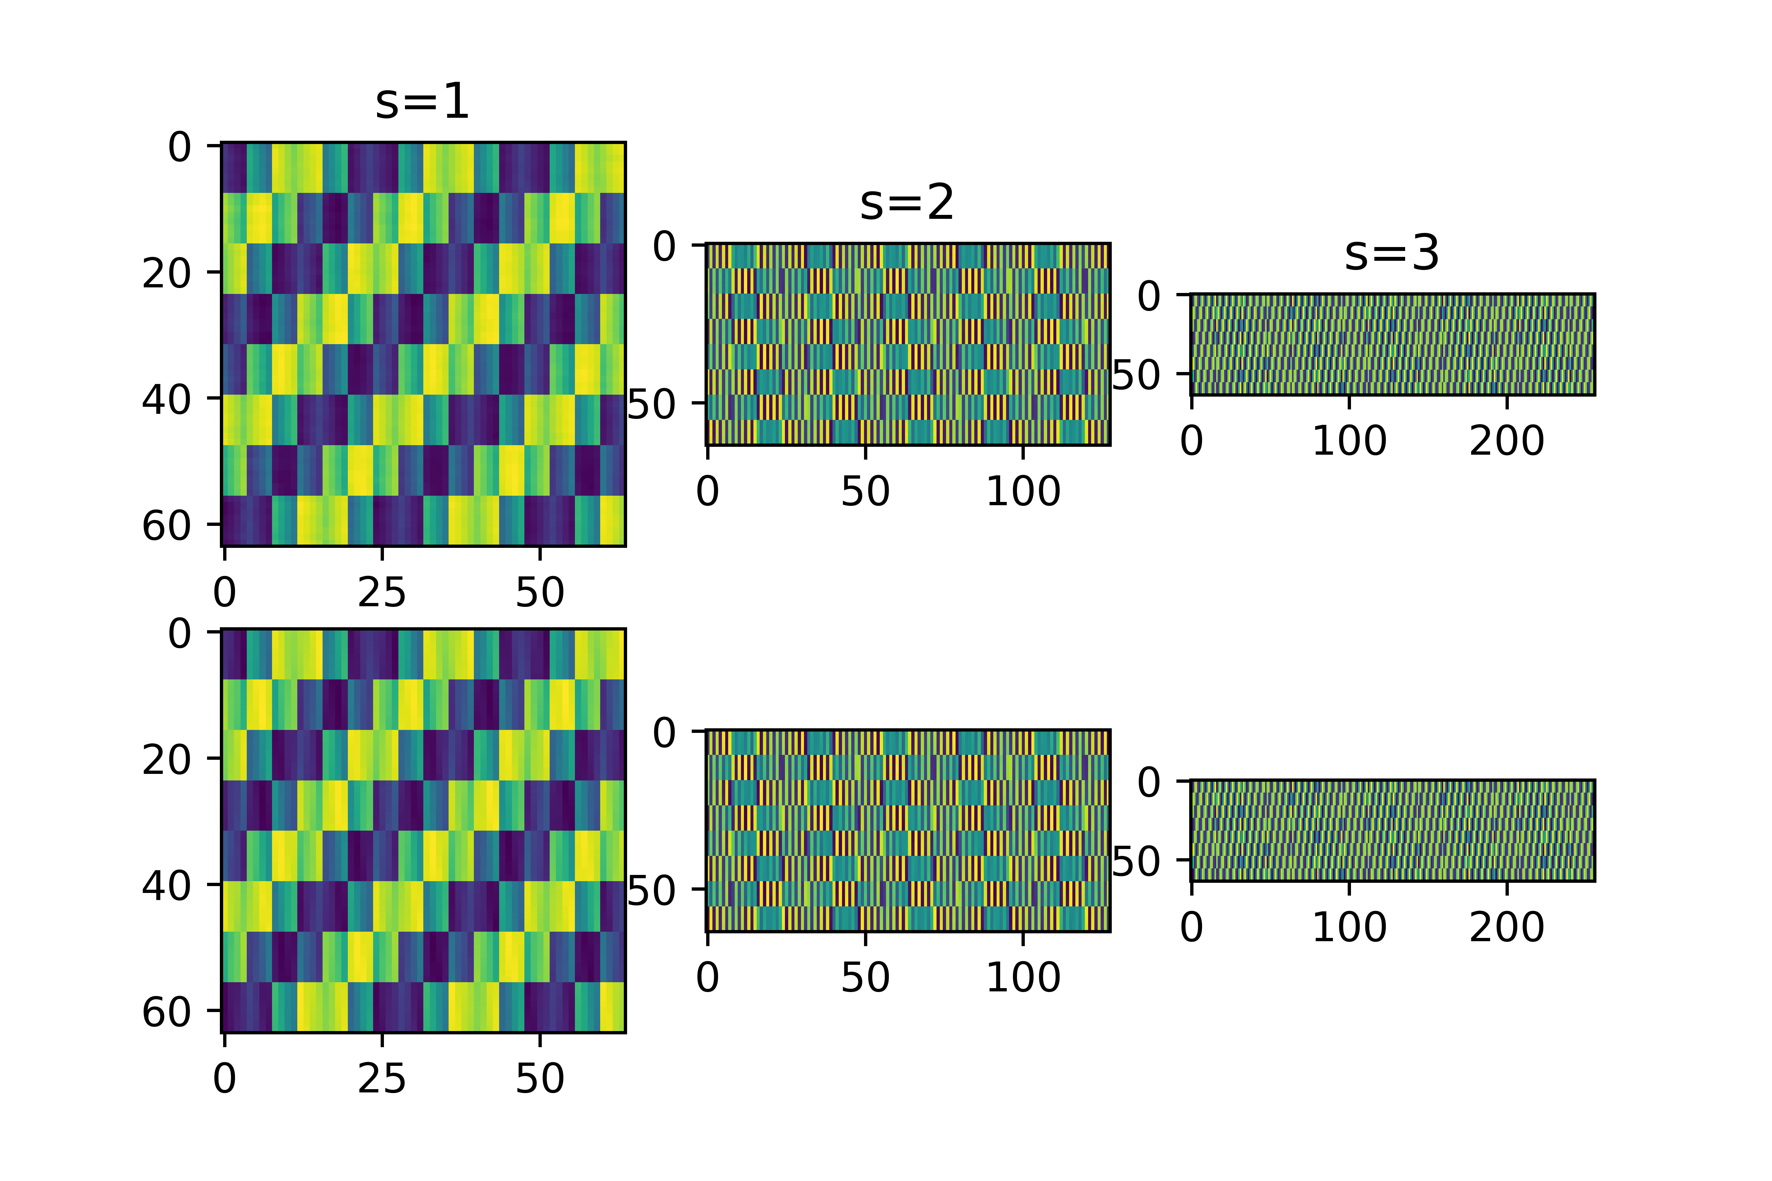
Simulation Results
  Limited pilot overhead
  Multi-scale feature visualization
Insights
  Multi-scale progressive estimation > single-stage estimation
  Dual-branch architecture enhances the effective information flow
  More parameters and FLOPs are needed in the Pyramid Network
Notes:
Furthermore, the NMSE performance of the proposed network under different pilot overhead. With the decrease of pilot overhead, the required upsampling dimension will be larger, so the reconstruction difficult will be increased. However, the proposed network can achieve satisfactory channel estimation accuracy even with little pilot overhead. We also visualize the output channel matrix of each reconstruction module in Laplacian pyramid network, which shows each module can learning the accuracy data distribution of cascaded channel in different scales. In conclusion, we found the multi-scale progressive estimation and dual-branch architecture can effectively improve the cascaded channel estimation accuracy, while more parameters and FLOPs are needed in the pyramid network.

Slide 11
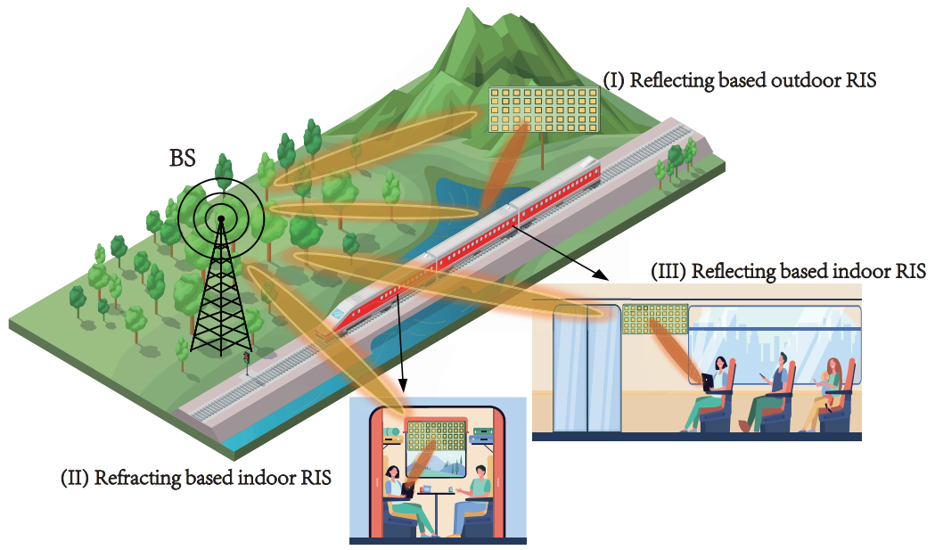
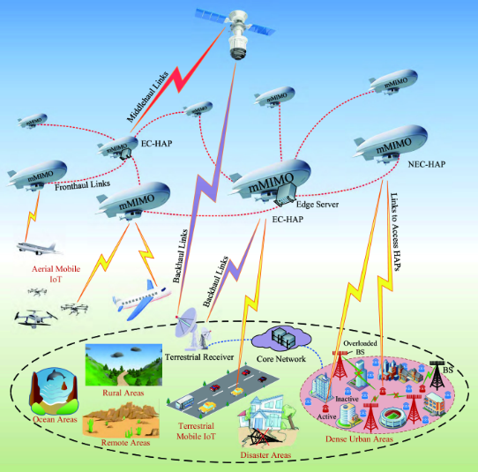
Future Directions
Multiple RISs aided cooperative communications
Mobile RIS aided V2V/SAGIN communications
Signal model
Equivalent channel
Doppler frequency shift—>Time selective fading
Notes:
In the future works, we will extend the proposed model to higher-dimensional channel estimation scenarios, e.g., cooperative communication of multiple RISs. Moreover, the channel estimation schemes in RIS-aided high-dynamic communication scenarios, such as V2V communications, high-speed train communications and integrated space-air-ground networks, is also a interesting research direction.

Slide 12
Thank you
Multi-Scale Supervised Learning-Based Channel Estimation for RIS-Aided Communication Systems
The related code is available at: https://github.com/Holographic-Lab/LPAN
Notes:
This is the end of the slide show. Thanks for your listening.

